Slide 1


Department of Electronics and Telecommunication (E&TC) Engineering Academic Year 2021-22
A PROJECT PRESENTATION ON
Canopy Detection and Pesticides Spraying Using Agricultural Drones
BY
1. SUDHIR BHAUSAHEB PAWAR
2. YASH NILESH SHINDE
3. HRISHIKESH VINOD MORE
GUIDED BY
Dr. Mrs. G. M. PHADE

Slide 2
INDEX
Introduction
Problem statement
Literature survey
Objective
Block diagram
Flowchart
Methodology
Hardware/Software
Advantages
Conclusion
Future scope
References

Slide 3
INTRODUCTION
This idea is to make a drone carrying a payload containing pesticides with the ability to detect green field and spraying only the required amount.
In past, there have been incidents in the news recently where farmers got injured and had to be hospitalized due to the hand spraying of chemical fertilizers. Hand spraying method for fertilizer is also inefficient as it causes overuse and thus decreasing soil’s nutrients.

Slide 4
PROBLEM STATEMENT
To design and develop cost effective agriculture drone for sapling detection and pesticides spraying purpose with the help of High Speed STM32 processor along with BLDC motors, Li-Po batteries, ESCs pesticides tank, pump and propellers and in the end to train the farmers to operate the drones.

Slide 5
LITERATURE SURVEY
Huang et al. (2015) made a low volume sprayer which is integrated into unmanned helicopters. The helicopter has a main rotor diameter of 3 m and a maximum payload of 22.7 kg. It used to require at least one gallon of gas for every 45 minutes. This study paved the way in developing UAV aerial application systems for crop production with higher target rate and larger VMD droplet size.
Chennai based ZUPPA provides farm, irrigation, and crop monitoring through use of drones and aerial mapping.

Slide 6
Kurkute et al. (2018) worked on a Quadcopter and has published a paper entitled “Drones For Smart Agriculture: A technical Report”. In this paper they give a brief idea about the UAV and its spraying mechanism using simple cost-effective equipment. The universal sprayer system is used to spray for both liquid and solid content.
Rahul Desale et al. (2019) described an architecture based on UAV that could be employed for agricultural applications. Their UAV was designed not only for spraying but also for monitoring agricultural fields with the use of cameras and GPS

Slide 7
OUTCOME OF LITERATURE SURVEY
Payload capacity of drones.
Automatic Crop Detection/Monitoring.

Slide 8
OBJECTIVE
Drone capable of carrying payload of 5 kg.
Drone with ability to detect a sapling autonomously.
Reducing the cost required for the drone compared to present solutions.

Slide 9
Block Diagram
Drone Base
Flight Controller
Esc’s & BLDC Motors
Raspberry Pi
LIPO Battery
Video (Sapling Detection)
Servomotors For Spraying
Sensers(LDR, Water Level Sensors)
Tank Status Monitoring
Raspberry Pi Camera
Receiver

Slide 10
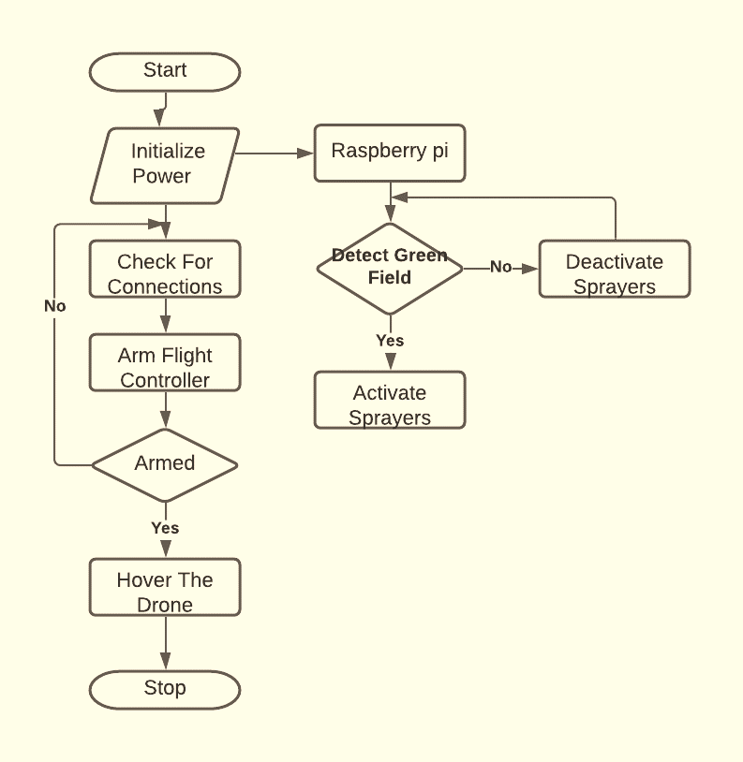
FLOWCHART

Slide 11
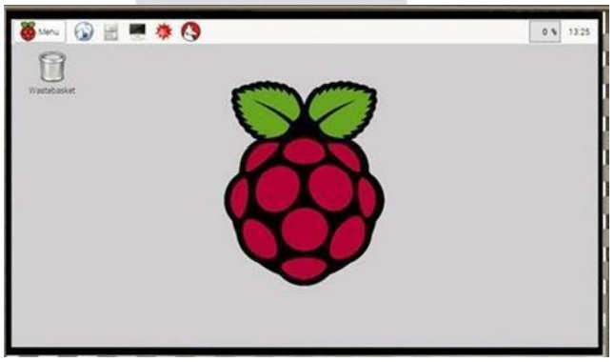
METHODOLOGY
RASPBERRY PI :-
It look like a credit card but it perform as a mini computer .it used for many things that desktop PC does like video word processing,
spread sheets, home automation server,
parent detectors to weather stations,
tweeting houses of birds with IR cameras etc.
After installing the Raspbian OS we can get the Raspberry pi desktop as shown in the fig
which is similar to our normal computer desktop.

Slide 12
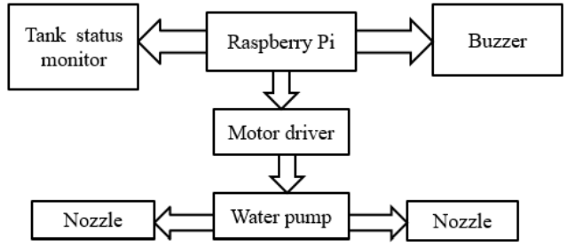
METHODOLOGY
Spraying Mechanism :-
There are a lot of plant protection products exist today. Main pesticides that used in precision agriculture are:
1) Insecticides
2) Fungicides
3) Herbicides
Crops spraying Drones suited ideally for
such task, because most fields needs ultra-
low application volumes of pesticides per hectare, only on some specific zones of a field and only at some specific time.

Slide 13
Hardware/Software
Software :
Raspberry Pi OS
Mission Planner
Python OpenCV
Hardware :
Drone
Raspberry Pi
Pump
Water Sprinkler
Motor Driver IC
Water Float Sensor

Slide 14
ADVANTAGES
High Productivity
Low Fuel Consumption
Low Noise Pollution
No chemical contamination risks for operator
Crop dusting costs are much lower
Ultra-low volumes spraying methods, avoids waste of water and ground waters contamination
Multifunctional Frame

Slide 15
CONCLUSION
This method of spraying pesticides on Agricultural fields reduces the number of labors, time, cost and the risk involved to the personnel involved in spraying the liquids. This drone can also be used in spraying disinfectant liquids over buildings, water bodies and highly populated areas.
Drone is responsible for both spraying chemicals and monitoring of agricultural fields, environment.
It helps in improves coverage, boosts chemical effectiveness and makes spraying job easier and faster.

Slide 16
FUTURE SCOPE
The maximum quantity of fertilizer that the drone carries can be increased.
Battery life can be increased.
With image processing techniques, the drone can be involved in surveillance to determine the pest attack on the plants, condition of ripening fruit.

Slide 17
REFERENCES
C. Zhang, J. M. Kovacs, ”The application of small unmanned aerial systems for precision agriculture: a review”, Precision Agriculture, Springer, 2012.
MIT Technology Review, ”Agricultural Drones. Relatively cheap drones with advanced sensors and imaging capabilities are giving farmers new ways to increase yields and reduce crop damage”, http://www.technologyreview.com/featuredstory/526491/agricultural-drones/, 2015.
I. Colomina, P. Molina, ”Unmanned aerial systems for photogrammetry and remote sensing: a review”, ISPRS Journal of Photogrammetry and Remote Sensing, June 2014.
L. Hassan-Esfahani, A. Torres-Rua, A. M. Ticlavilca, A. Jensen, M. McKee, “Topsoil Moisture Estimation for Precision Ag riculture Using Unmanned Aerial Vehicle Multispectral Imagery”, 2014 IEEE International Geoscience and Remote Sensing Symposium, 2014.

Slide 18
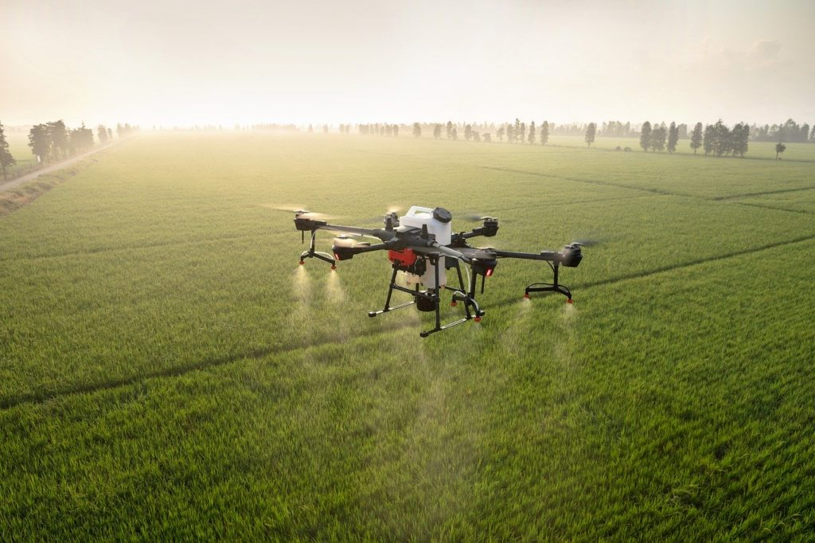
Thank
You..

